Slide 1
FMG/FAZ VRRP Example

Slide 2
Design Options
There are three options (currently and not limited to) for deploying FMG/FAZ using VRRP in Azure namely:
Option 1 - Using Azure Load Balancer with FMG/FAZ VRRP as documented in this link. https://community.fortinet.com/t5/FortiManager/Technical-Tip-FortiManager-VRRP-HA-configuration-in-Azure-Public/ta-p/267503. In this setup, Azure LB will be load balancing connection to FMG that are in VRRP mode. FortiGate will be connecting to public IP on Azure LB and Azure LB will send the traffic to the FMG that are active.
Option 2 - Configure FMG/FAZ similarly as option 1 without Azure Load Balancer and there is no need to have managed identities with roles to be assigned. Both Primary and Secondary FMG/FAZ will have Public IP associated with the Primary IP. In FMG/FAZ VRRP configuration, you will use the Private IP as peer IP and a dummy IP can be configured for VIP. In both FMG/FAZ, you will configure both FMG/FAZ public IP as shown below.
config system admin setting
set mgmt-fqdn <fmg-1-public-ip> <fmg-2-public-ip>
end
Once FGT cannot communicate with the first FMG, it will switch over to the second FMG.

Slide 3
Design Options
Option 3 - Using Azure API call to switch over the Public IP from Primary to Secondary FMG/FAZ as documented in this link. https://docs.fortinet.com/document/fortimanager/7.4.0/new-features/518211/fortimanager-ha-support-automatic-vrrp-failover-in-azure-7-4-2.
Please take note of the following:
If Primary IP have Public IP, it need to be of SKU “standard” instead of basic as it need to match with the secondary IP's Public IP SKU of standard (required for Public IP switchover).
Required to upload all the Azure root CA files into FMG/FGT. https://learn.microsoft.com/en-us/azure/security/fundamentals/azure-ca-details?tabs=root-and-subordinate-cas-list
Role required for FMG/FAZ managed identities minimally be Contributor and Reader. Contributor role alone is not enough.
For Secondary IP, it can be static or dynamic, however, Public IP have to be static.
Not recommended to have Public IP on the primary IP as it will cause routing issue and FGT will not be able to communicate with FMG/FAZ using the secondary IP's Public IP.
For Remote management of both Primary and Secondary FMG/FAZ, there are two recommendations:
Create a separate interface with a different vNET, have a inbound NAT device (LB) and assigned a public IP to it.
Spin up a Jumphost (Windows or Linux) and use it to manage FMG/FAZ using the primary IP address.

Slide 4
Option 2 Setup Information

Slide 5
Things to Take Note
How to spin up of FMG/FAZ is not included in this documentation. It is assumed that user have the knowledge to spin up FMG/FAZ in Azure.
This only show FMG VRRP Option 2 setup information. It is assumed that FAZ can be setup using the same steps.
For Management of FMG/FAZ, user can GUI to the respective Public IP that is assigned to both Primary and Secondary FMG/FAZ.

Slide 6



FMG/FAZ Option 2 High Level Setup
10.0.0.0/16
Public subnet
10.0.1.0/24
Port1
10.0.1.4
Public IP1
Primary FMG
Secondary FMG
Port1
10.0.1.5
Public IP2
FMG/FAZ VRRP Setup
FMG/FAZ Management Option using Second Interface
FortiGate will be connecting to both Public IP 1 and Public IP 2 so that it can be managed by FMG/FAZ

Slide 7
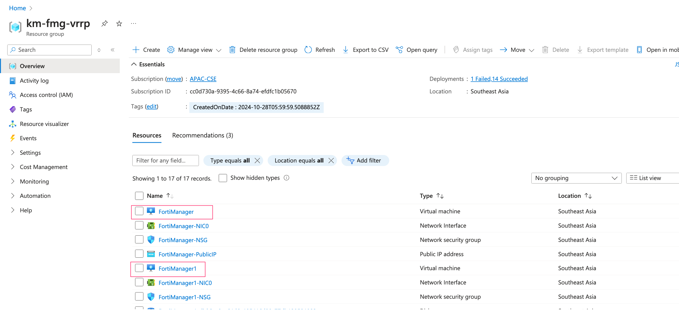
Azure FMG Instances
Two standalone FortiManager should already be spin up.
Network Security Group and Routing should already be configured correctly.

Slide 8
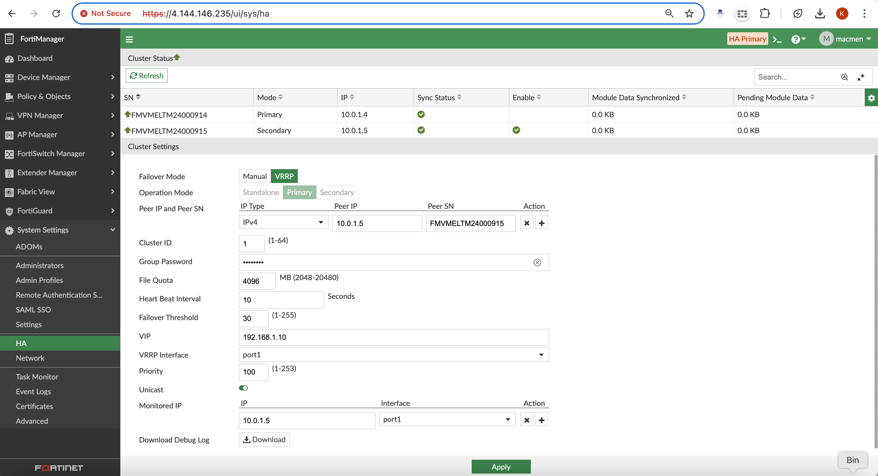
Primary FortiManager Configuration
Primary FMG Public IP
Primary FMG Private IP
Secondary FMG Serial No
Secondary FMG Private IP
Dummy IP
Higher Priority than Secondary FMG
Monitor Secondary FMG Private IP

Slide 9
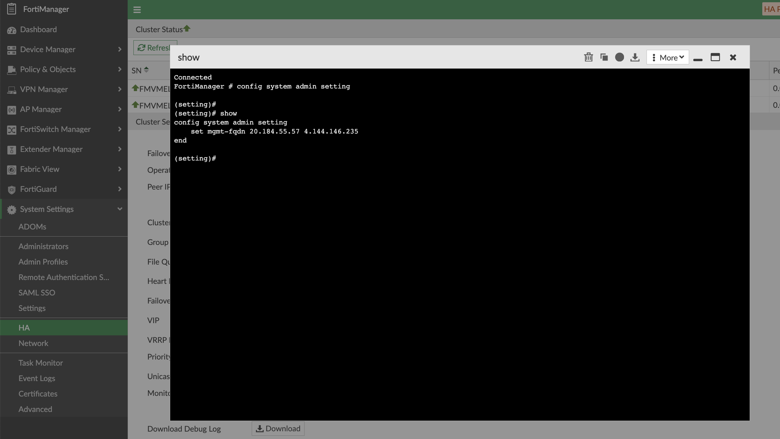
Primary FortiManager Configuration
Configure both Primary and Secondary FMG Public IP here.

Slide 10
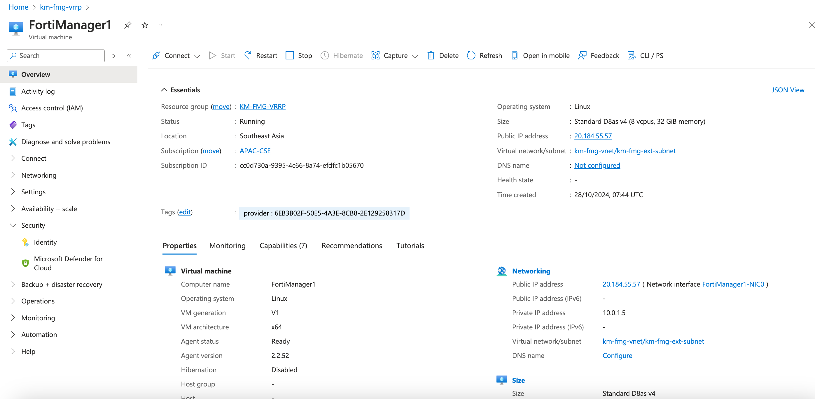
Azure Secondary FortiManager Configuration
Public IP
Private IP

Slide 11
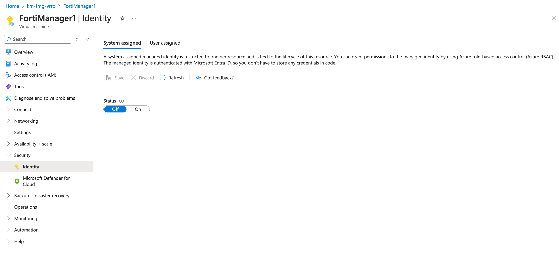
Azure Secondary FortiManager Configuration
Do not need to have managed identity or IAM to be set up.

Slide 12
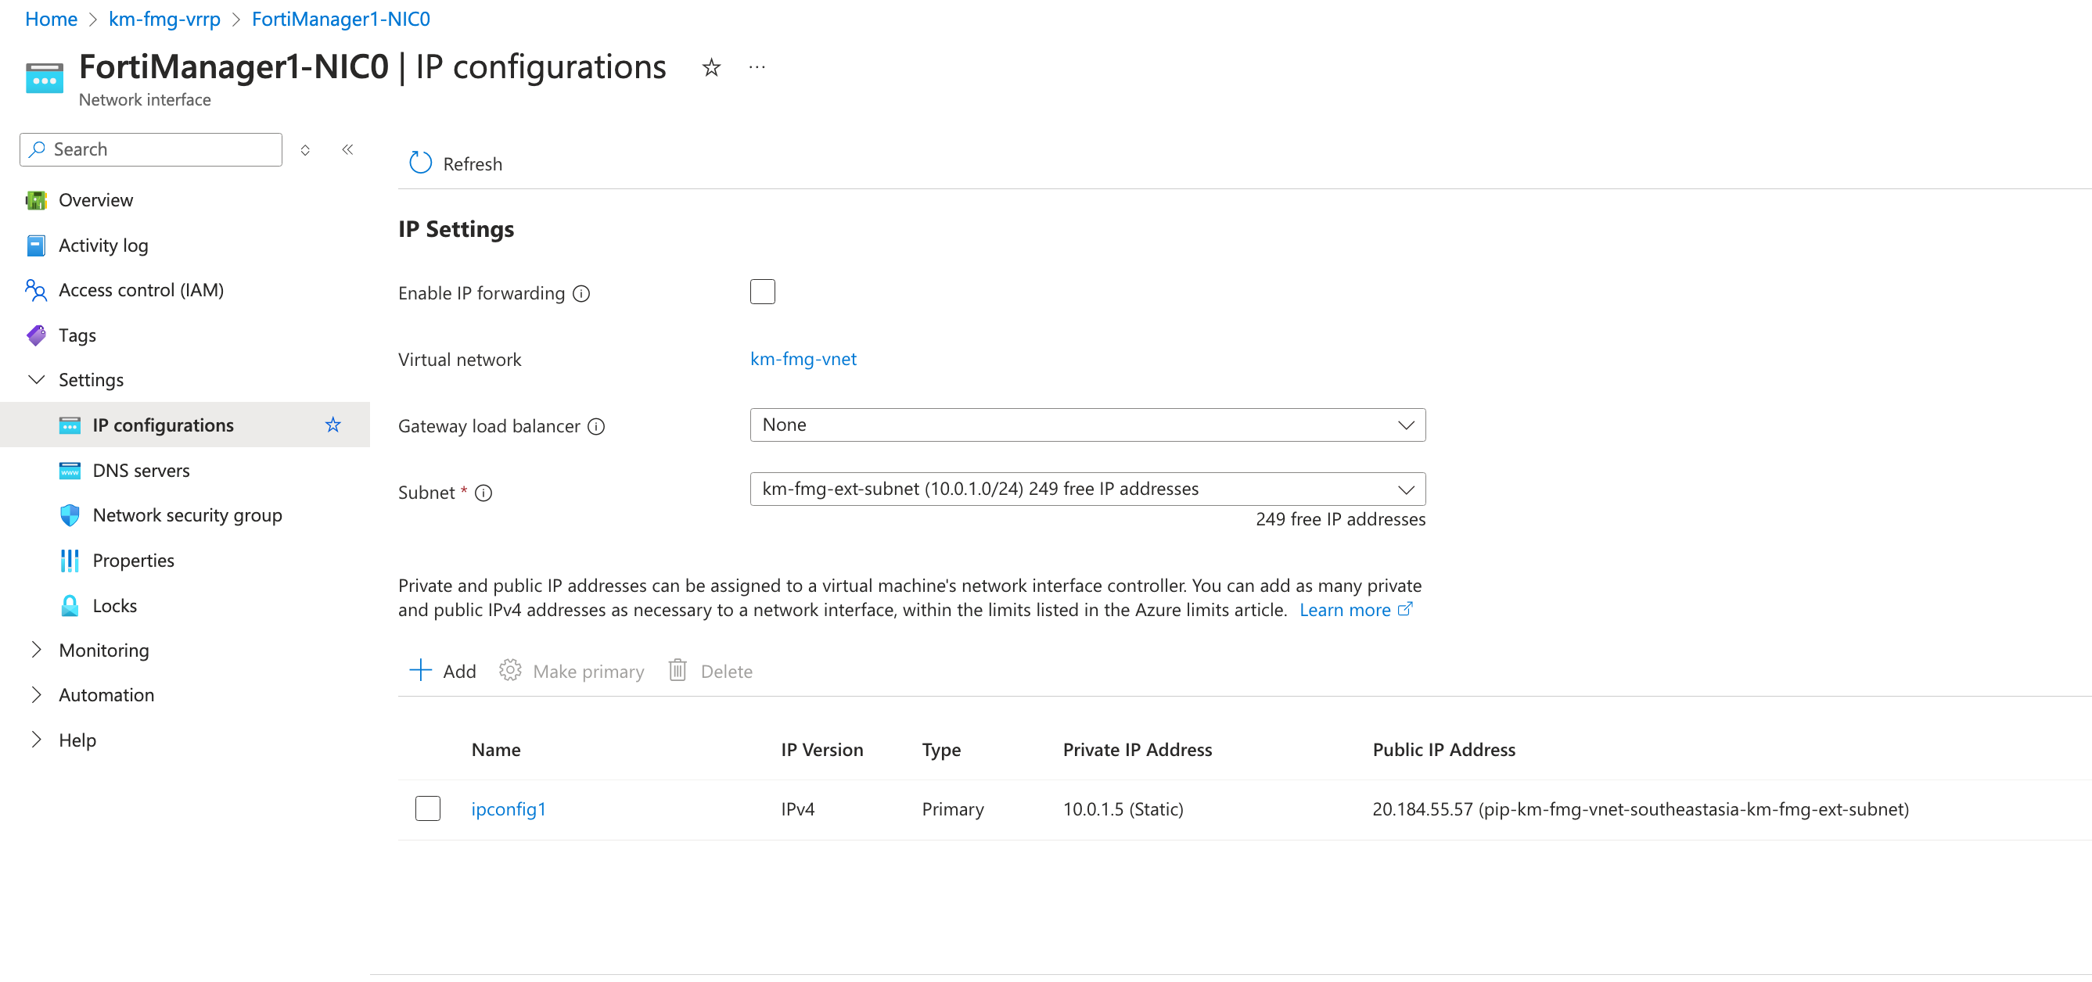
Azure Secondary FortiManager Configuration
Only Primary IP is required, no need to have secondary IP

Slide 13

Secondary FortiManager Configuration
Secondary FMG Public IP
Secondary FMG Private IP
Primary FMG Serial No
Primary FMG Private IP
Dummy IP
Lower Priority than Primary FMG
Monitor Primary FMG Private IP

Slide 14
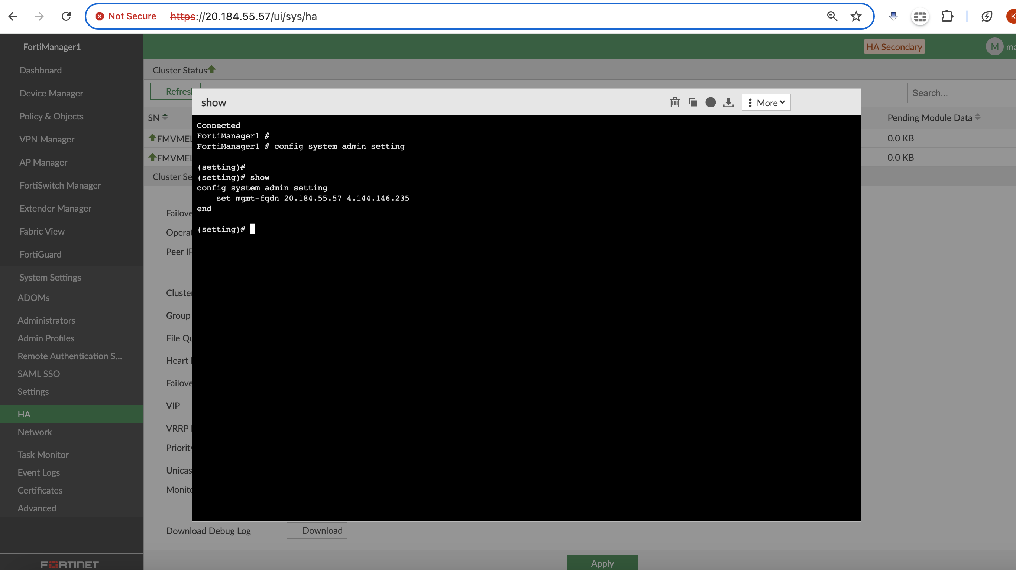
Secondary FortiManager Configuration
Configure both Primary and Secondary FMG Public IP here.

Slide 15
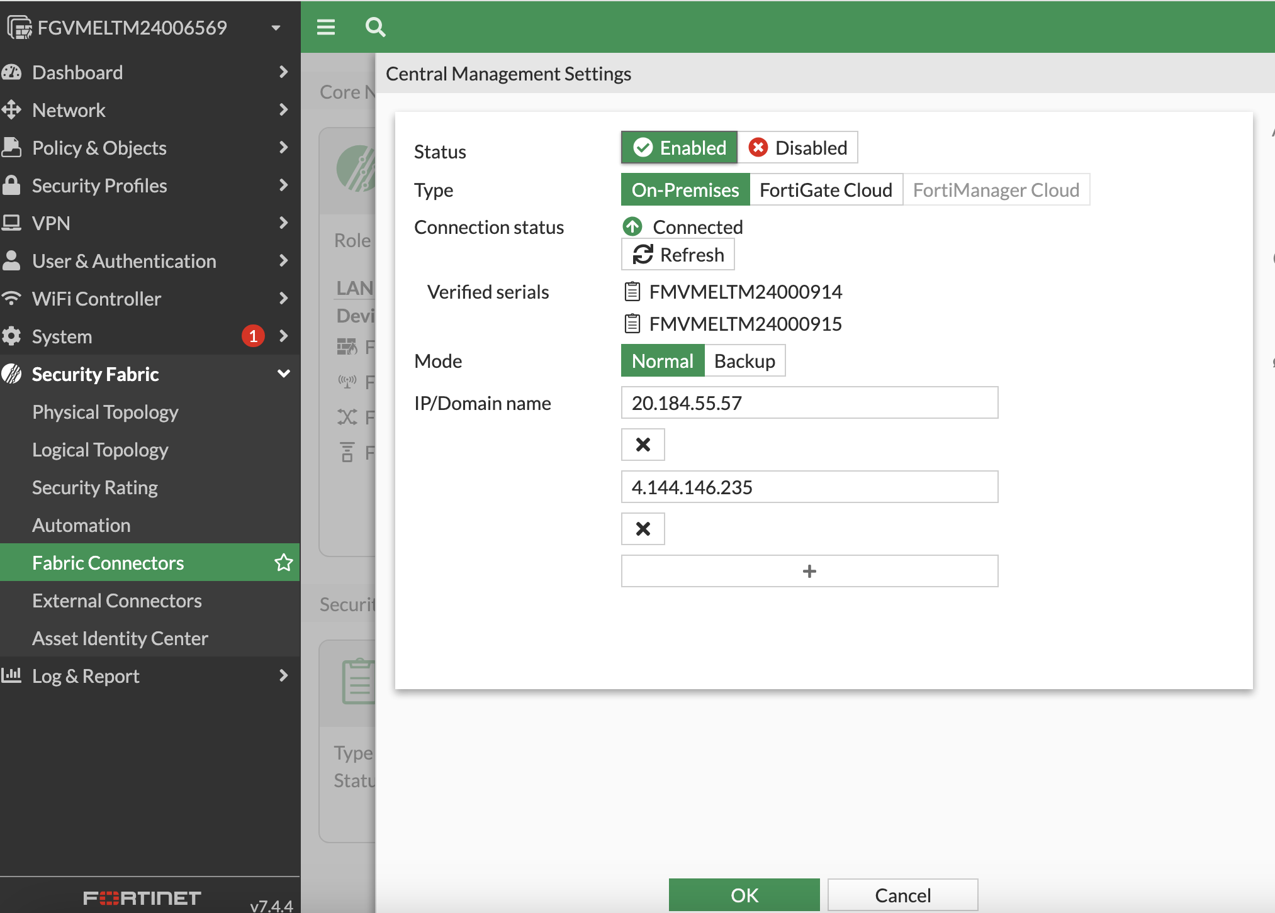
FortiGate Configuration
Both Primary and Secondary FMG serials will be verified
Configure both Primary and Secondary FMG Public IP here.

Slide 16
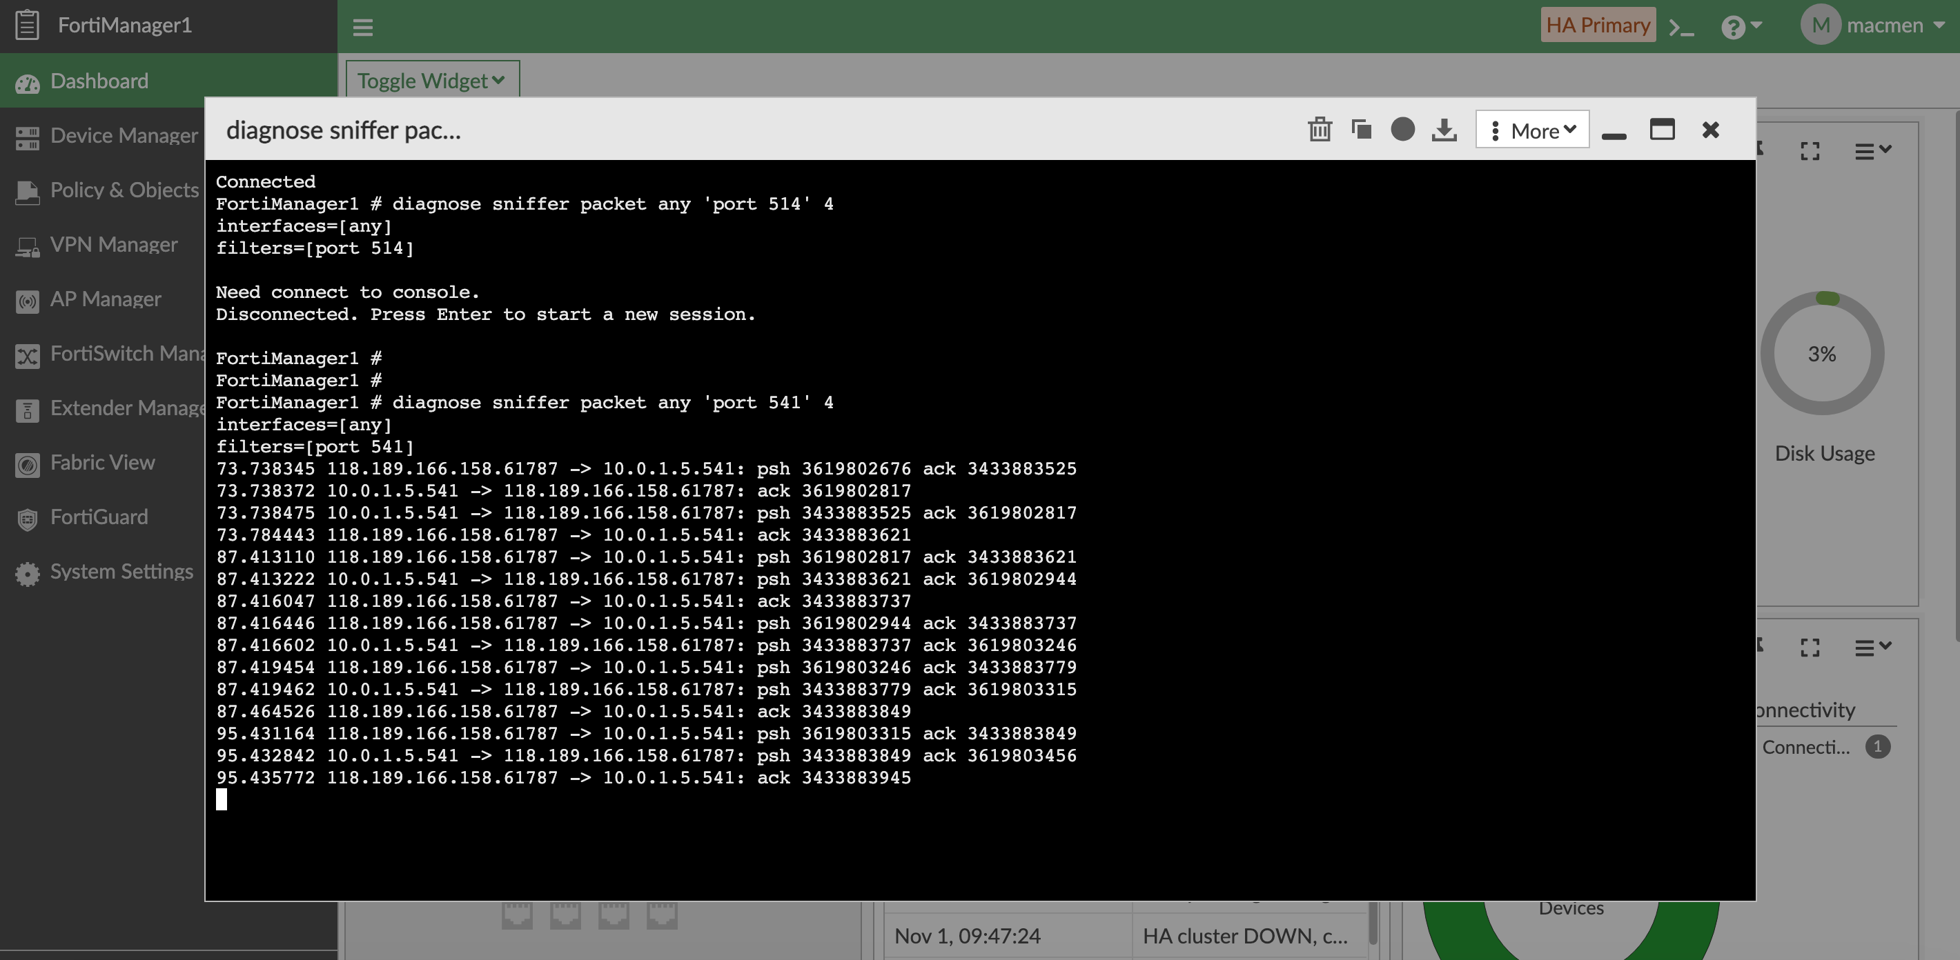
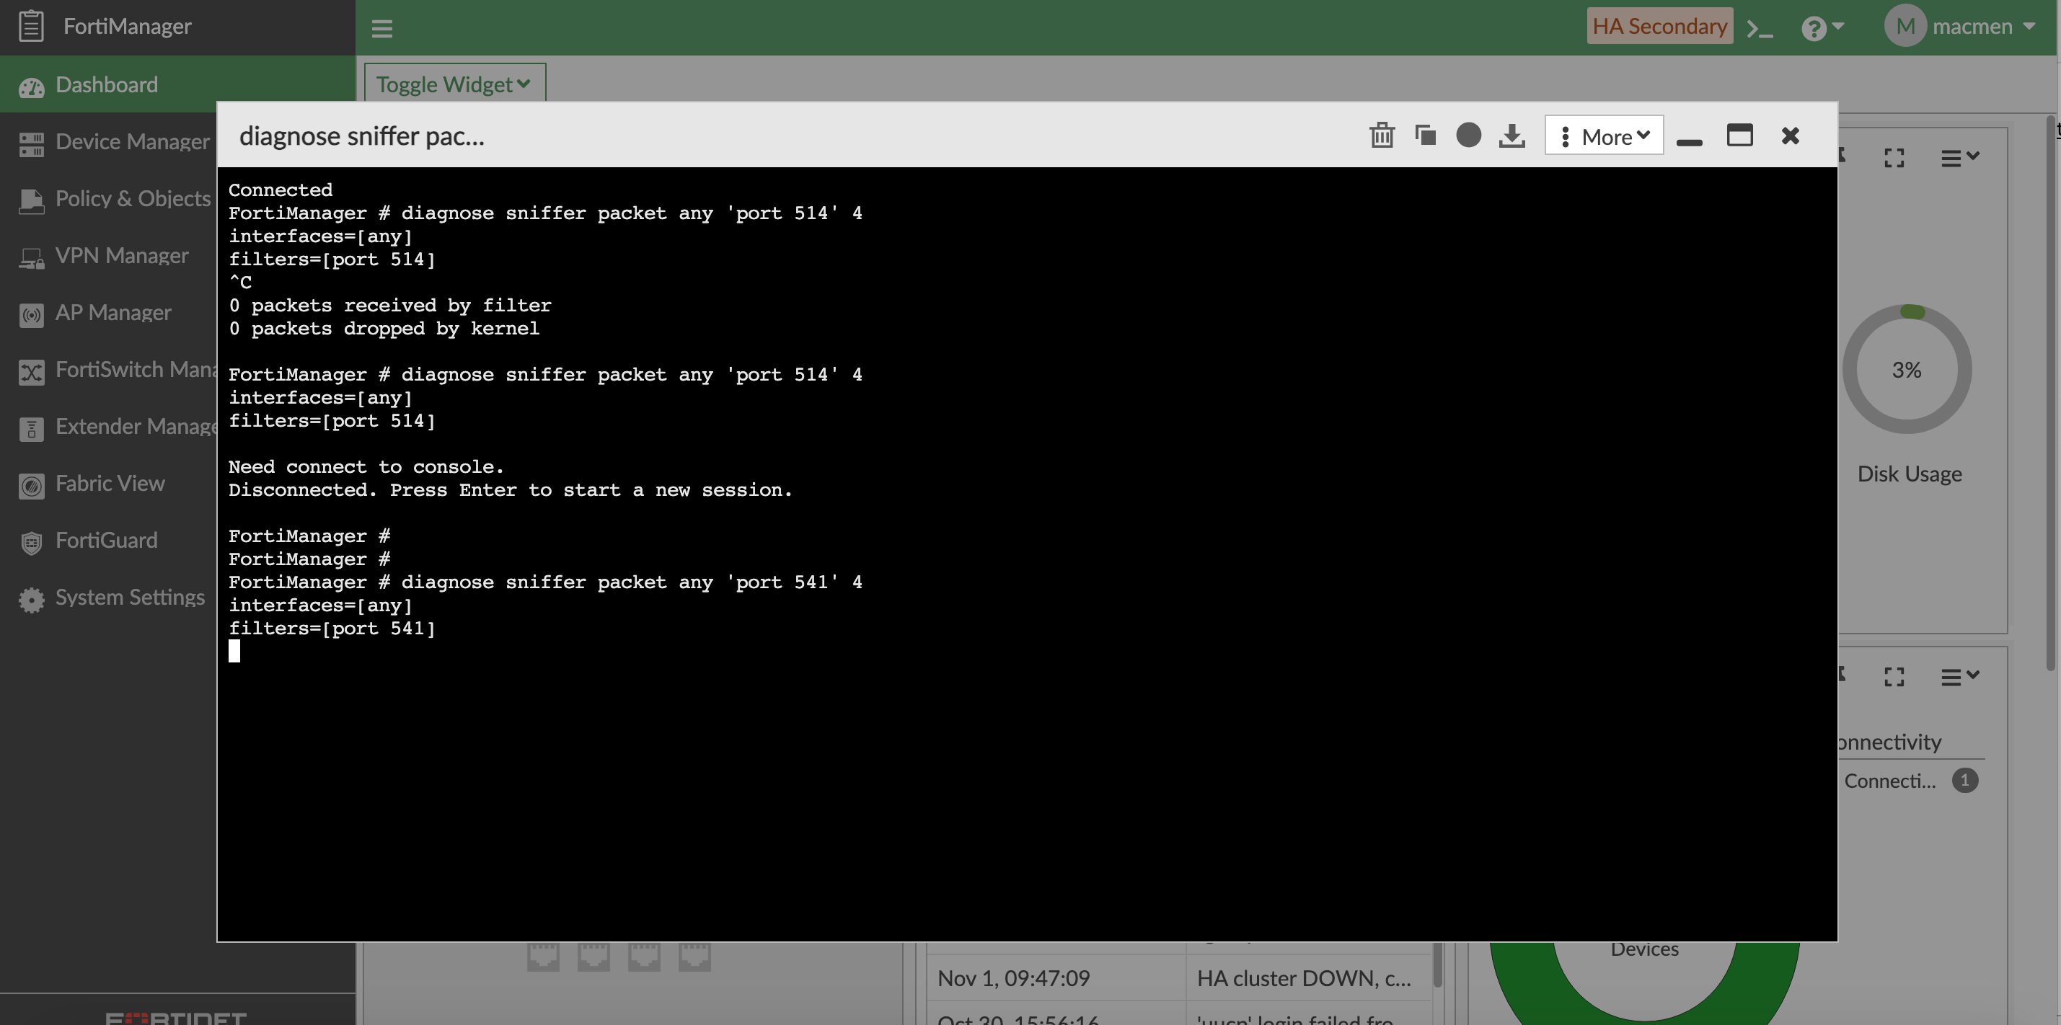
Option 2 Verification
- Failover of Primary from “FortiManager” to “FortiManager 1”.
Primary
Secondary
FortiGate is communicating with Primary FMG (FortiManager 1) only
FortiGate is not communicating with Secondary FMG (FortiManager).

